Slide 1
Scripting plan

Slide 2


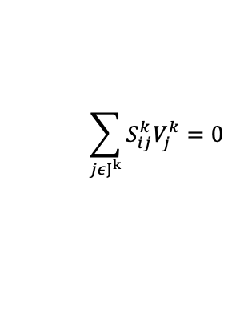
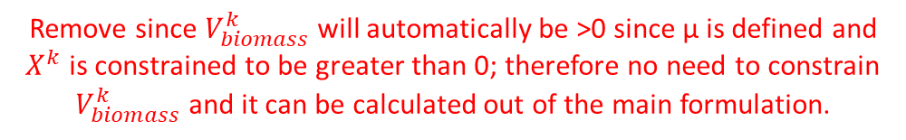

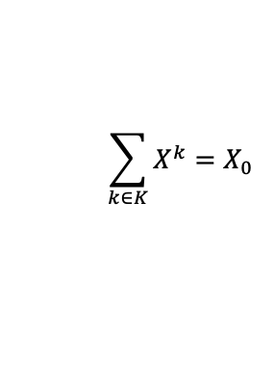
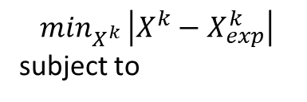
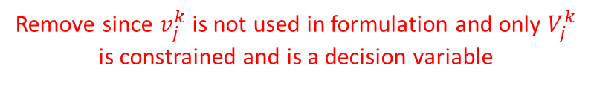




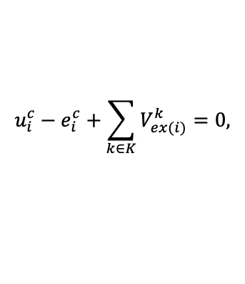




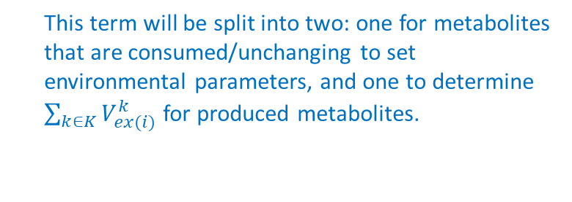
Adapted SteadyCom Formulation
$$\min_{X^{k} }\left|X^{k}−X_{exp}^{k}\right|$$
subject to
Remove since $v_{j}^{k}$is not used in formulation and only $V_{j}^{k}$ is constrained and is a decision variable
$V_{j}^{k}=X^{k}v_{j}^{k}$, $∀j∈J^{k}$, $k∈K$
$$\sum_{jεJ^{k}}{S_{ij}^{k}V_{j}^{k}=0}$$
$$∀i∈I^{k}$$
$$∀k∈K$$
${LB}_{j}^{k}X^{k}≤V_{j}^{k}≤{UB}_{j}^{k}X^{k}$,
$$∀j∈J^{k}$$
Remove since $V_{biomass}^{k}$will automatically be >0 since µ is defined and $X^{k}$ is constrained to be greater than 0; therefore no need to constrain $V_{biomass}^{k}$ and it can be calculated out of the main formulation.
$$V_{biomass}^{k}=X^{k}μ$$
$$X^{k}≥0$$
$$u_{i}^{c}−e_{i}^{c}+\sum_{k∈K}{V_{ex(i)}^{k}=0,}$$
This term will be split into two: one for metabolites that are consumed/unchanging to set environmental parameters, and one to determine $\sum_{k∈K}{V_{ex(i)}^{k}}$ for produced metabolites.
$$∀i∈I^{com}$$
$$\sum_{k∈K}{X^{k}=X_{0}}$$
$$μ$$
,
$$e_{i}^{c}≥0$$
,
$$∀i∈I^{com}$$
Notes:
X^k is a variable here.

Slide 3


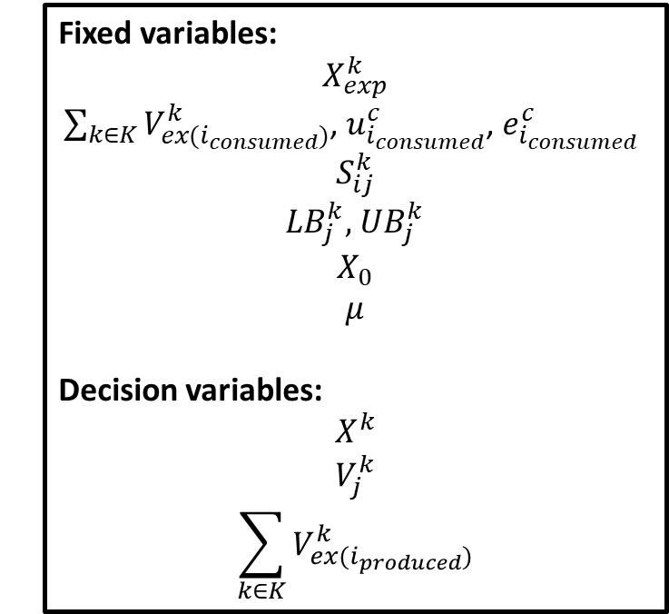
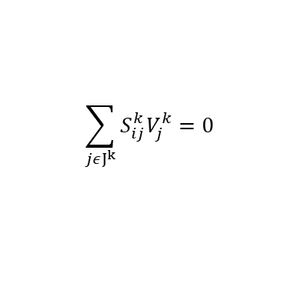



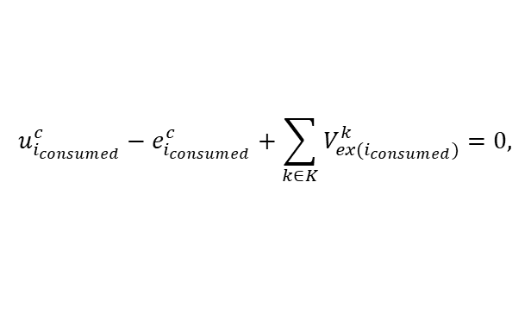

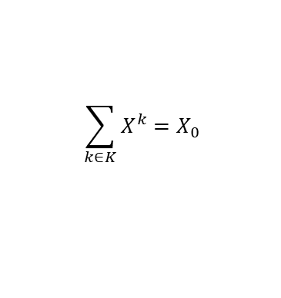



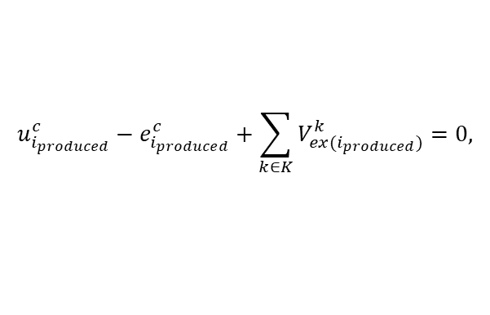

Adapted SteadyCom Formulation
$$\min_{X^{k} }\left|X^{k}−X_{exp}^{k}\right|$$
subject to
Fixed variables:
$$X_{exp}^{k}$$
$\sum_{k∈K}{V_{ex(i_{consumed})}^{k}}$, $u_{i_{consumed}}^{c}$, $e_{i_{consumed}}^{c}$
$$S_{ij}^{k}$$
${LB}_{j}^{k},$ ${UB}_{j}^{k}$
$$X_{0}$$
$$μ$$
Decision variables:
$$X^{k}$$
$$V_{j}^{k}$$
$$\sum_{k∈K}{V_{ex(i_{produced})}^{k}}$$
$$\sum_{jεJ^{k}}{S_{ij}^{k}V_{j}^{k}=0}$$
$$∀i∈I^{k}$$
${LB}_{j}^{k}X^{k}≤V_{j}^{k}≤{UB}_{j}^{k}X^{k}$,
$$∀j∈J^{k}$$
$$∀k∈K$$
$$X^{k}≥0$$
$$u_{i_{consumed}}^{c}−e_{i_{consumed}}^{c}+\sum_{k∈K}{V_{ex(i_{consumed})}^{k}=0,}$$
$$∀i_{consumed}∈I^{com}$$
$$u_{i_{produced}}^{c}−e_{i_{produced}}^{c}+\sum_{k∈K}{V_{ex(i_{produced})}^{k}=0,}$$
$$∀i_{produced}∈I^{com}$$
$$\sum_{k∈K}{X^{k}=X_{0}}$$
$$μ$$
,
$$e_{i}^{c}≥0$$
,
$$∀i∈I^{com}$$
Notes:
X^k is a variable here.

